Slide 1

Maximizing Revenue for Drivers
Using Payment Type

Slide 2

AGENDA
Problem Statement
Research Questions
Data overview
Methodology
Analysis and Findings
Hypothesis Testing
Recommendations

Slide 3

Problem Statement
In the fast-paced taxi booking sector, making the most of revenue is essential for long-term success and driver happiness. Our goal is to use data-driven insights to maximise revenue streams for taxi drivers in order to meet this need. Our research aims to determine whether payment methods have an impact on fare pricing by focusing on the relationship between payment type and fare amount.

Slide 4
Research Question
Is there a relationship between total fare amount and payment type?
How can we strategically encourage customers to choose payment methods that increase driver revenue while ensuring a seamless and positive customer experience?

Slide 5
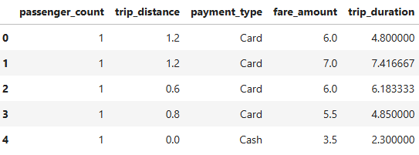
Data Overview
For this Analysis we have used a part of the dataset of NYC Yellow Taxi Trip records, used data cleaning and feature engineering procedures to focus solely on the realevant data essential for our investigation.
Relevant Data for this analysis:
passenger_count(0-5)
payment_type(Cash/ Card)
fare_amount
trip_distance
trip_duration(minutes)

Slide 6
Methodology
Steps | Description
Descriptive Analysis | Analyzed the data to identify key trends in fare amounts and payment methods. Removed unusual or incorrect values to ensure accuracy and reliability. Summarized important insights to help understand customer payment preferences and overall fare patterns, making the data more useful for decision-making.
Hypothesis Testing | Performed a T-Test to examine whether fare amounts vary based on payment methods. This analysis helps determine if there is a significant difference in fares between different payment types, providing insights into potential pricing patterns or customer preferences.

Slide 7
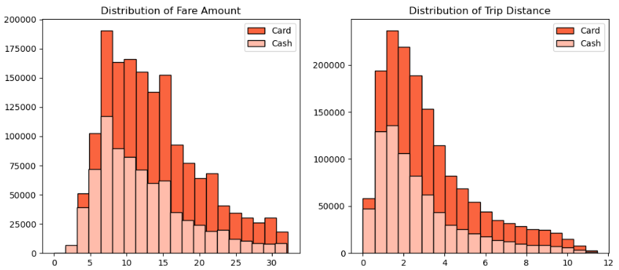
Journey Insights
Customers using cards tend to have higher average trip distances and fare amounts compared to cash payments.
Higher fare amounts and longer trips are more commonly paid for using cards, suggesting a preference for cashless transactions in such cases.
This indicates that card payments are the preferred choice for longer and more expensive rides.
Payment Type | Fare Amount |  | Trip Distance
Card | Mean | Std | Mean | Std
 | 13.701903 | 6.506356 | 3.230729 | 2.320528
Cash | 12.250209 | 6.246104 | 2.803716 | 2.231871

Slide 8
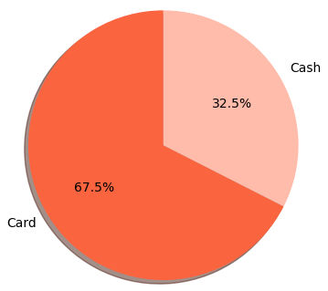
Preference of payment types
A majority of customers prefer card payments, making up 67.5% of all transactions, while cash payments account for 32.5%.
This suggests that convenience, security, and possible incentives may drive customers toward using cards over cash.
The strong preference for cashless transactions highlights the growing trend of digital payments in the market.

Slide 9
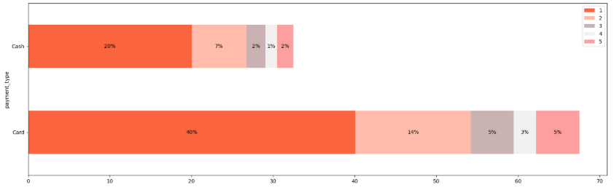
Passenger Count Analysis
Card Transactions: Single-passenger rides (passenger_count = 1) dominate card payments, representing 40.08% of all card-based transactions. This indicates a strong preference for card payments among solo travelers.
Cash Transactions: Similarly, cash payments are primarily associated with single-passenger trips, accounting for 20.04% of all cash transactions.
Behavioral Insights: As the passenger count increases, the percentage of transactions steadily declines. This suggests that larger groups may prefer alternative transportation methods or payment options outside the traditional taxi system.

Slide 10
Hypothesis Testing
We conducted hypothesis testing to determine whether payment methods influence average fare rates.
Null Hypothesis: There is no difference in the average fare between customers who use credit cards and those who use cash.
Alternative Hypothesis: There is a significant difference in the average fare between these two payment methods.
Our analysis yielded a T-statistic of 165.5 and a P-value of less than 0.05, leading us to reject the null hypothesis. This confirms that payment method does have a statistically significant impact on the average fare.

Slide 11
Recommendations
To enhance revenue generation for taxi drivers and improve overall customer convenience, we propose the following targeted strategies:
Incentivize Credit Card Payments – Offer exclusive discounts or promotions for customers who opt for credit card transactions, encouraging greater adoption of this payment method.
Enhance Payment Convenience & Security – Streamline the credit card payment process by ensuring seamless and secure transactions, reinforcing trust and reliability among riders.
Educate & Promote Benefits – Actively communicate the advantages of credit card payments to customers, emphasizing ease of use, rewards, and enhanced payment flexibility.
Implementing these recommendations can lead to increased customer satisfaction, improved financial transparency, and maximized earnings for taxi drivers.

Slide 12
Thank You!

